Slide 1
React useContext

Slide 2
React context is the way to manage state globally.
State should be held by the highest parent component in the stack that requires access to the state.
To illustrate, we have many nested components. The component at the top and bottom of the stack need access to the state.
To do this without Context, we will need to pass the state as "props" through each nested component. This is called "prop drilling".

Slide 3
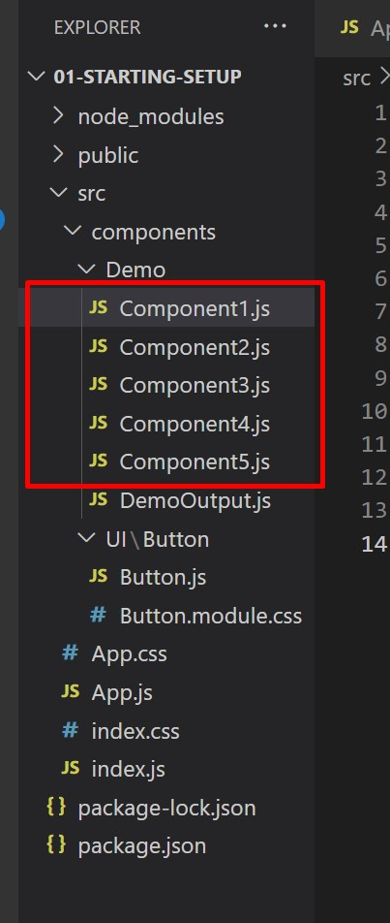
In the useCallback example only, prepare the Components as shown.

Slide 4
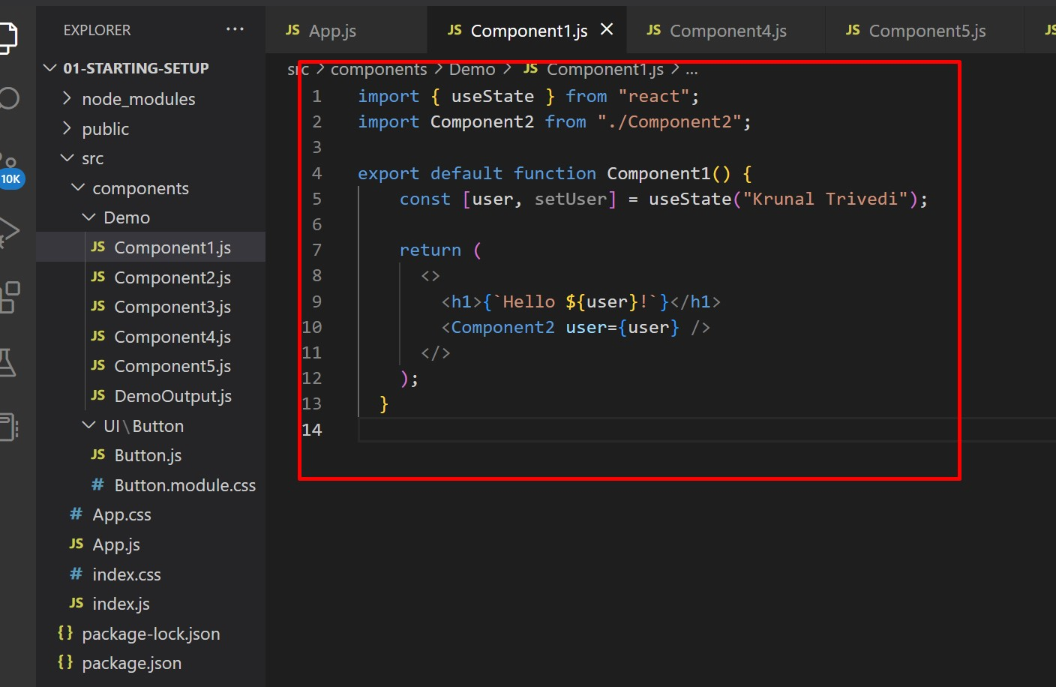
Component1.js

Slide 5
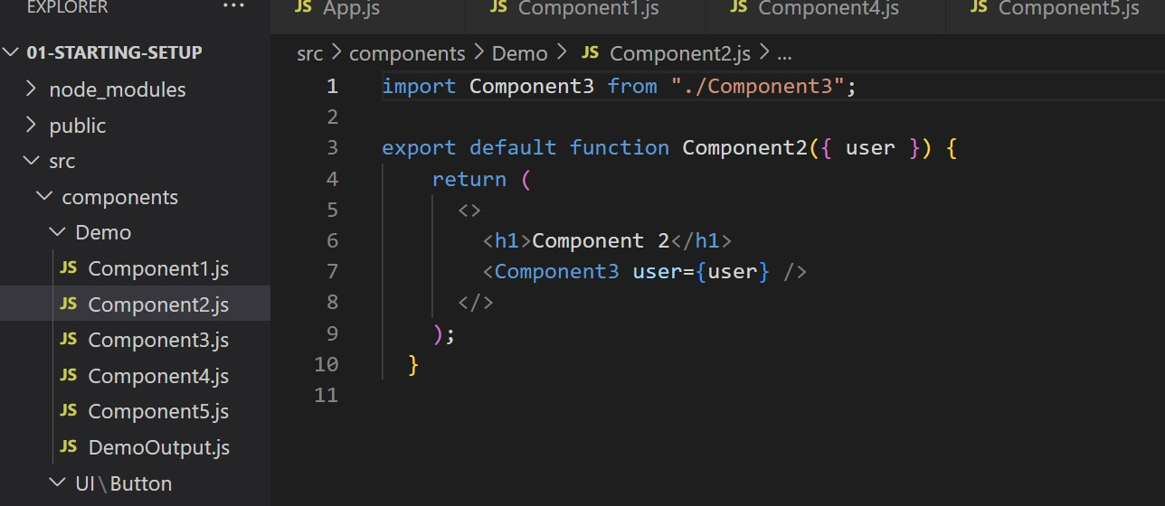
Component2.js

Slide 6
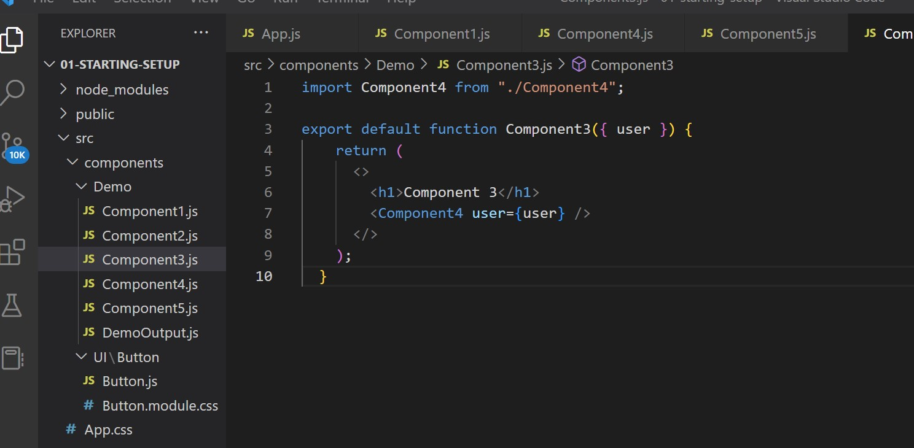
Component3.js

Slide 7
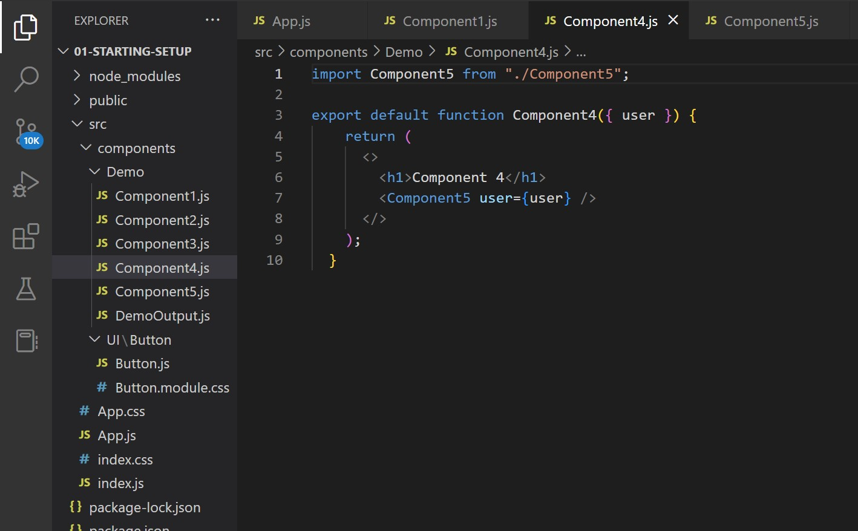
Component4.js

Slide 8
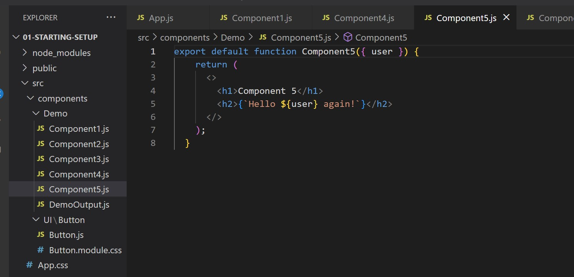
Component5.js

Slide 9
Even though components 2-4 did not need the state, they had to pass the state along so that it could reach component 5.

Slide 10
The solution is to create context.

Slide 11
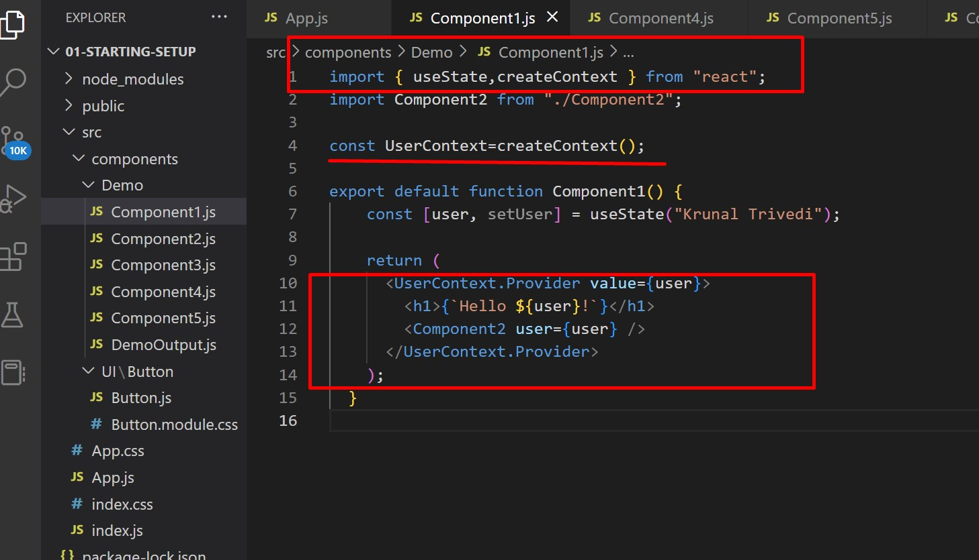
To create context, you must Import createContext and initialize it:

Slide 12
Now, all components in this tree will have access to the user Context.

Slide 13
Use the useContext Hook
In order to use the Context in a child component, we need to access it using the useContext Hook.

Slide 14
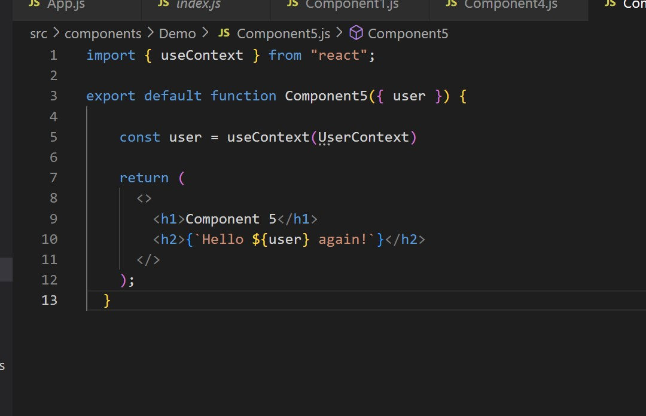
Run application and check output.

